Slide 1
Summary of Phase I Product Failure
Melissa Wooten

Slide 2
Basic Structure of the Dataset
Each row in the dataset represents a specific product. There are a total of 26,570 rows/products in the dataset.
The dataset contains several columns (also known as variables) with different types of information about each product. Some key columns include:
Id: an identifier for each product or observation
Product code: A categorical variable indicating the product code or category to which each product belongs
Loading: a numerical variable that represents the loading value associated with each product.
Attributes 2 and 3 are numerical variables containing attribute information related to the products
Measurements 0 to 17 are numerical variables representing various measurements or attributes associated with the products
There were a significant number of rows with missing data. I took the mean of each column and replaced the missing data with the mean for the respective column

Slide 3
The Target Variable: Failure
The target variable, in our dataset, is called 'failure.' It is a binary variable that indicates whether a product has experienced failure or not. In other words, it tells us whether a product has encountered a problem or malfunction during its usage.
The 'failure' variable is crucial because it allows us to identify products that have had issues or failures. This information is valuable for quality control and can help us make informed decisions to prevent future failures.
I took the failure column and converted No’s to 0’s and Yes’s to 1’s.

Slide 4
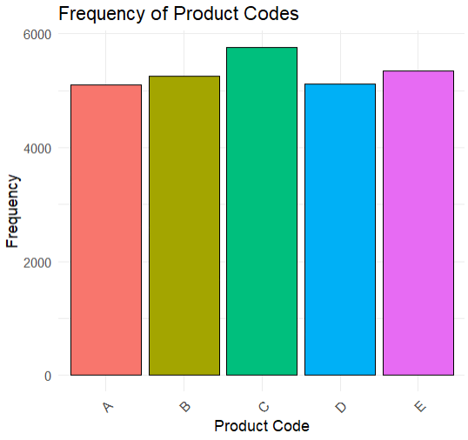
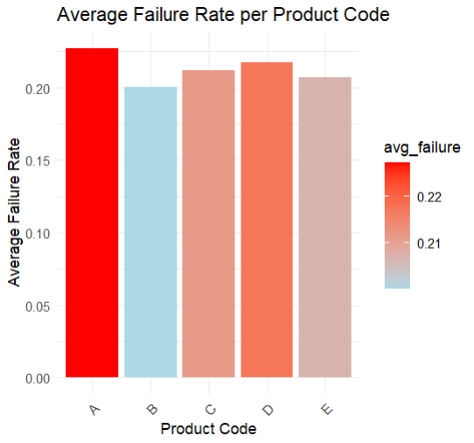
Exploring the other variables
The number of unique product codes in the data set is 5.
The average failure rate per product code:
Product Code A: The failure rate for this product code is about 22.7%. This indicates that based on the "Yes" designation in the failure table, about 22.7% of the goods with code A are classed as failures.
Product Code B: The failure rate for product code B is about 20.0%.
Product Code C: The failure rate for product code C is about 21.2%.
Product Code D: The failure rate for product code D is about 21.8%.
Product Code E: The failure rate for product code E is about 20.7%.

Slide 5
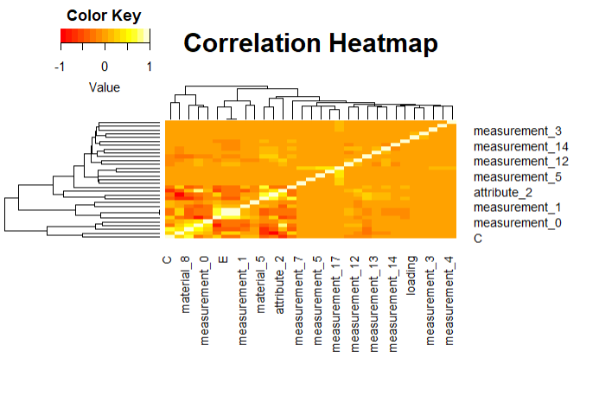
Heat Map
A heat map helps you see what variables are associated with each other by using colors to show the strength and direction of those associations. It's like looking at a weather map to understand how temperatures vary across different places – only in this case, you're exploring the relationships between variables in your data.
This heat map tells us:
There is a strong positive correlation between attribute 15 and product failure
There is a strong negative correlation between attribute 2 and product failure.
There is a weak positive correlation between measurement 15 and product failure

Slide 6
What do the correlations mean?
Attribute 15: the higher the values for attribute 15 the higher the likelihood of product failure. Lower values for attribute 15 are associated with lower likelihoods of product failure.
Attribute 2: As the value for attribute 2 increases the likelihood of product failure decreases.
Measurement 15: There is a tendency for product failure to increase as product failure increases but the association between measurement 15 and product failure is not very prominent.

Slide 7
Converting Categorical Data
Simple Binary conversion for Attribute 0.
One-hot Encoding for Product Code and Attribute 1
How One-hot encoding works:
1. Think of a pizzeria where the three pizza options on the menu are Margherita, Pepperoni, and Veggie. Your order will be placed using a system that eliminates the need to write down the name of the pizza:
2. They mark the Margherita column with a checkmark (or a 1) and leave the other columns empty (or 0) for Margherita.
They mark the Pepperoni column with a checkmark and leave the other columns at 0.
3. In the same way, Veggie.
4. We made a new column for each distinct value in these columns. We enter a 1 in the corresponding new column and a 0 in the other columns if the original data included that value.

Slide 8
Summary of Phase II Product Failure
Melissa Wooten

Slide 9
Building the Predictive Model - Logistic Regression
Logistic regression is a commonly used statistical method for binary classification problems, making it suitable for predicting product failures (binary outcome: Yes or No).
To effectively evaluate the model, the dataset is divided into training and testing sets.
The training set is used to train the model, while the testing set is used to evaluate the model's performance.
Techniques like stratified sampling may be utilized to ensure a representative split, particularly when dealing with imbalanced classes.

Slide 10
Interpretation of Model Evaluation Metrics
Accuracy: The accuracy of the predictive model is approximately 77.98%. This means that the model correctly predicted product failures for about 77.98% of the instances in the test set.
Precision: The precision of approximately 78.02% indicates that when the model predicted a product failure, it was correct about 78.02% of the time. Precision measures the proportion of true positives among all predicted positives.
Recall (Sensitivity): The recall of approximately 99.90% suggests that the model effectively captured almost all actual product failures, indicating a high sensitivity to identifying failures.
F1 Score: The F1 score, which is approximately 87.62%, is the harmonic mean of precision and recall. It provides a balance between precision and recall, considering both false positives and false negatives.

Slide 11
Model Evaluation Metrics
Model evaluation metrics are essential to assess the performance of the predictive model.
Key evaluation metrics for the model include:
Accuracy: The proportion of correctly predicted instances out of the total instances.
Precision: The proportion of true positives out of the total predicted positives.
Recall: The proportion of true positives out of the total actual positives.
F1 Score: The harmonic mean of precision and recall, providing a balance between the two metrics.

